Slide 1
Second Life
Amanda Lohr

Slide 2
Botanica’s Butterfly Hunt
In this featured destination some rare and endangered butterflies have injured and may need help. This destination allows you to help capture the butterflies that need help and return them for a reward.
See the next slide for a picture
Slurl: http://maps.secondlife.com/secondlife/Gecco/225/149/24

Slide 3
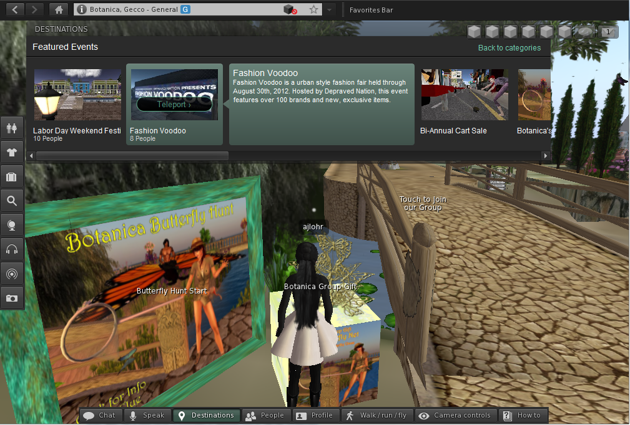
Fun and interactive way to learn about endangered species

Slide 4
Architecture 101
This ‘portal’ is a very cool destination that students can use for review their vocabulary for geometry in Math. Your SL (Second Life) character walks down a hall and to the left and right there are different terms. The picture you will see is showing information that reflects the term ‘Plane’.

Slide 5
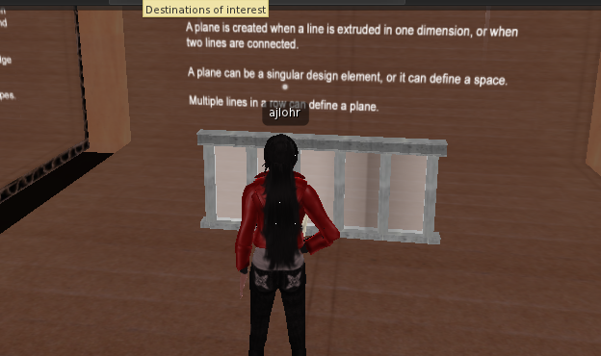
Slurl: http://maps.secondlife.com/secondlife/Architecture%20Island/96/186/1173

Slide 6
PlantPet Co-op
At this destination you will learn about plants, purchasing them, planting them and taking care of them. This is a great Science site.
The following slide shows me viewing the different plants that are available for purchase
Slurl: http://maps.secondlife.com/secondlife/Hardrada/28/213/46

Slide 7
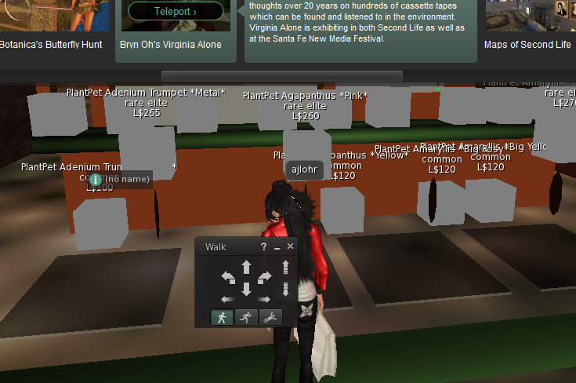
PlantPet

Slide 8
Chamonix City
This destination takes the user to Paris, France for some ice fishing on a pier. This is destination is multi-cultural as it provides FAQ in multiple languages and exposes the user to multiple cultures.
The screen shot I took was of the ice fishing area near the ‘warming shack’
Slurl: http://maps.secondlife.com/secondlife/Blueliner/133/46/23

Slide 9
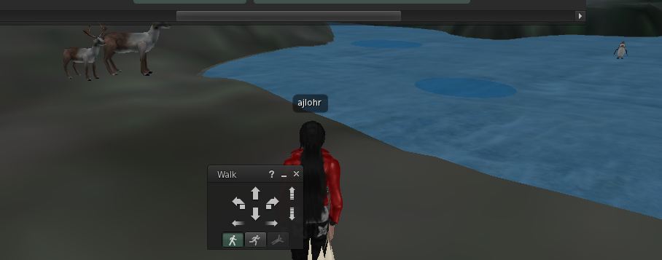
Chamonix Ice Fishing Pier

